Slide 1
dino
By awakeneddragon11

Slide 2
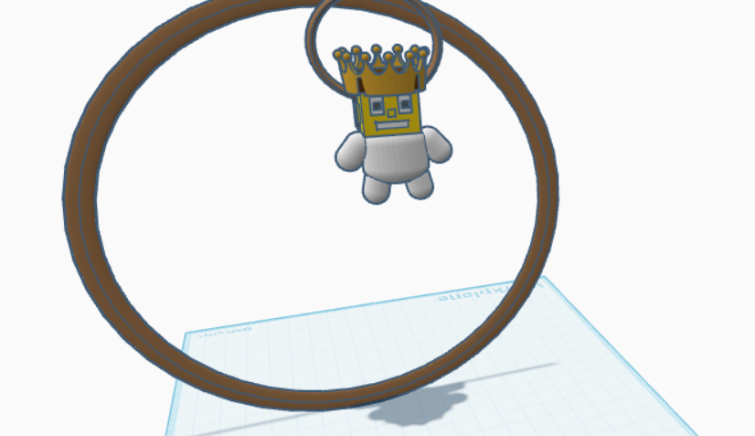
Get the amazing federo ron or king fedora

Slide 3
The fedora ron is a very premeire key chain that you like if you don’t like it steven he will beat you like he did to thanos. Bye and emotional damage.

Slide 4
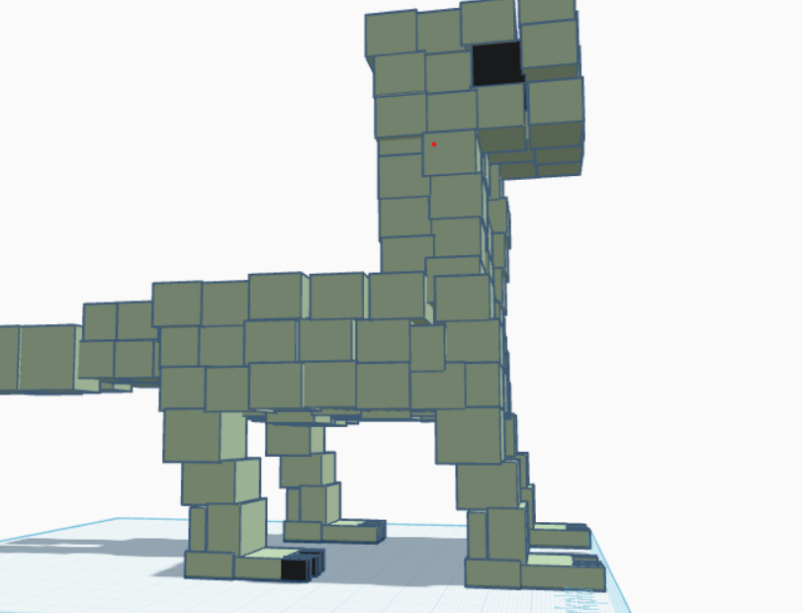

Slide 5
Get your amazing blocky bronto from us with amazing quality and members get 20% off.

